Slide 1


Machine Learning and Deep Learning Series Open Lab 4: Unsupervised Learning
Data Science & Analytics
Namig Abbasov

Slide 2
Machine Learning and Deep Learning Series
Open Lab 1: Introduction to Machine Learning and Deep Learning
Open Lab 2: Supervised Learning – Classification
Open Lab 3: Supervised Learning – Regression
Open Lab 4: Unsupervised Learning
Clustering
Dimensionality Reduction
Association Analysis
Open Lab 5: Advanced ML – Ensemble Learning and Optimization
Open Lab 6: Deep Learning and Neural Networks
Open Lab 7: Transformer-based Models

Slide 3
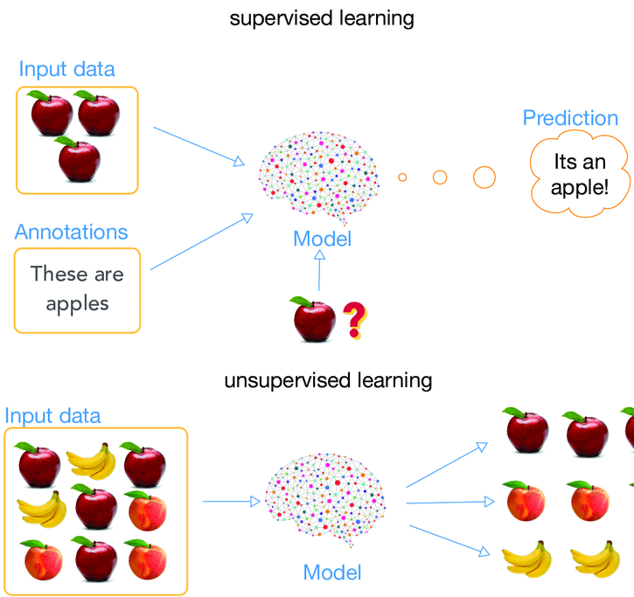
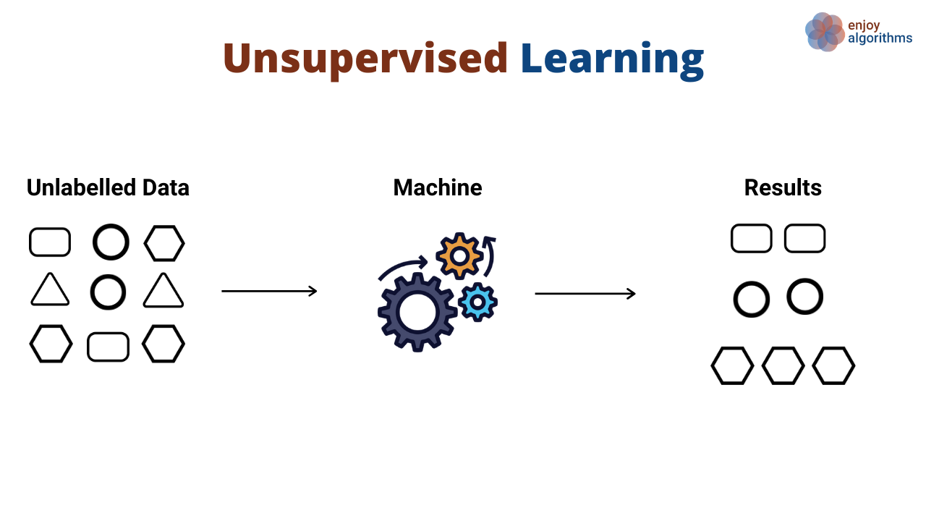
Unsupervised Learning Reminder

Slide 4
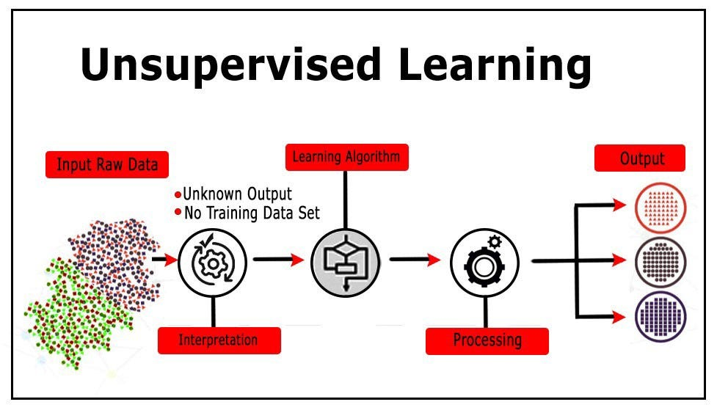
Unsupervised Learning Process
No labels
Complexity
unpredictable results
No one true answer: more interpretation
Domain knowledge

Slide 5
Supervised vs Unsupervised: Classification vs. Clustering
Var1 | Var2 | Var3 | Var4 | Var5 | Var6 | Var7 | Var8 | Var9 | class
94.99 | 105.35 | 10.56 | 10.45 | 105.46 | 106.34 | 107.39 | 109.22 | 101.22 | 1
9.55 | 10.35 | 100.56 | 100.45 | 10.55 | 55.49 | 10.21 | 10.44 | 10.25 | 0
9.77 | 10.35 | 100.56 | 100.45 | 10.46 | 10.34 | 10.39 | 10.22 | 10.22 | 0
94.96 | 105.35 | 10.56 | 10.45 | 105.46 | 106.34 | 107.39 | 109.22 | 101.22 | 1
94.98 | 105.35 | 10.56 | 10.45 | 105.46 | 106.34 | 107.39 | 109.22 | 101.22 | 1
9.90 | 10.35 | 103.56 | 104.45 | 10.46 | 10.34 | 10.39 | 10.22 | 10.22 | 0
94.99 | 105.35 | 10.56 | 10.45 | 105.46 | 106.34 | 107.39 | 109.22 | 101.22 | 1
Customer ID | Age | income | Spending Score(1-100) | Groups/Clusters
232 | 20 | 99,000 | 99 | ?
243 | 39 | 70,000 | 49 | ?
123 | 55 | 99,000 | 51 | ?
567 | 81 | 95,000 | 20 | ?

Slide 6
Unsupervised Learning: Text Classification vs. Topic Modeling
Text Classification
1 | Stocks Sink as Stubborn Inflation Resets. | Business
2 | Biden Denounces Trump’s Support for Russian Attack on Allies as ‘Un-American’ | Politics
3 | This Arctic Circle Town Expected a Green Energy Boom | Climate Change
 | Topic Modeling
1 | I love driving my car on the open road
2 | The engine of my vehicle is very powerful
3 | Libraries have thousands of books to read
4 | Reading a good book is a joy
5 | Cooking fresh meals is therapeutic
6 | A kitchen is a place where meals are made
Topic 1: {car, driving, engine, vehicle, road}
Topic 2: {libraries, books, read, joy}
Topic 3: {cooking, meals, therapeutic, kitchen}

Slide 7
Key Techniques in Unsupervised Learning
Clustering
Dimensionality Reduction
Association Rule Mining

Slide 8
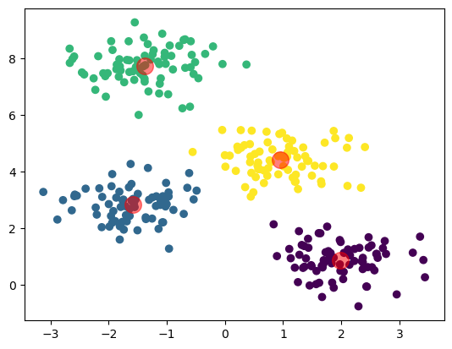
Understanding Clustering
“Clustering is task of dividing unlabeled data/data points into different clusters such that similar data points fall in the same cluster than those which differ from others.”

Slide 9
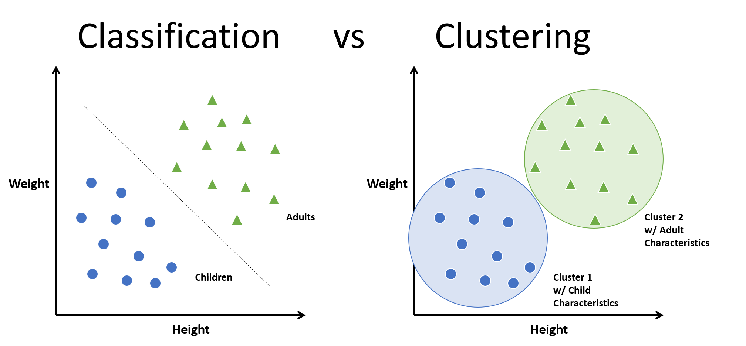

Slide 10
Clustering Example
Customer ID | Age | income | Spending Score (1-100) | Groups/Clusters
232 | 20 | 55,000 | 50 | ?
243 | 39 | 70,000 | 51 | ?
123 | 55 | 99,000 | 51 | ?
567 | 81 | 95,000 | 20 | ?
212 | 20 | 60,000 | 55 | ?
267 | 39 | 70,000 | 49 | ?
190 | 55 | 99,000 | 51 | ?
512 | 81 | 95,000 | 22 | ?

Slide 11
Cluster | Characteristics | Marketing Strategy
Group 1 | Young, high earners with high spending scores. Active in purchasing trendy items. | Online advertising campaigns for new and trendy products.
Group 2 | Middle-aged, moderate earners with moderate spending scores. Prefers value for money. | Promotions, discounts, and loyalty rewards.
Group 3 | Older, affluent customers with lower spending scores. Interested in premium products. | Exclusive offers on high-quality, premium products.

Slide 12
Types of Clustering Methods
Centroid-based / Partitioning Clustering
Key Algorithm: K-Means
Clusters are represented by centroids
Hierarchical/Connectivity-based Clustering
Key Algorithms: Agglomerative (AGNES), Divisive(DIANA)
Builds hierarchy of clusters
Density-based Clustering
Key Algorithm: DBSCAN (Density-Based Spatial Clustering of Applications with Noise)
Clusters are formed based on regions of high point density.
Distribution-based Clustering
Key Algorithm: Gaussian Mixture Models (GMM)
Assumes data is generated from multiple Gaussian distributions - probabilistic

Slide 13
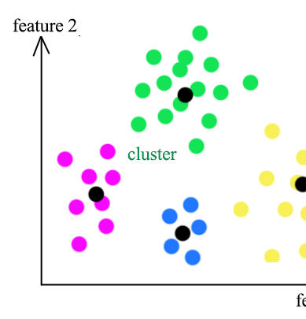
Centroid-Based Clustering
Cluster data points by their proximity to centroid
Euclidean distance: shortest (straight-line) distance between points, typically utilized for numerical features (default).
Manhattan distance: Calculated as sum of absolute differences along each dimension - suitable for categorical features.
Hamming distance: Computes percentage of differing bits between binary features - effective for binary data.
Mahalanobis distance: standardized version of Euclidean distance, considering covariance matrix of data.
Minkowski distance: generalized form encompassing both Euclidean and Manhattan distances, characterized by parameter determining degree of similarity.
Chebyshev distance: Determines maximum absolute difference along any dimension - a robust measure for dissimilarity.

Slide 14
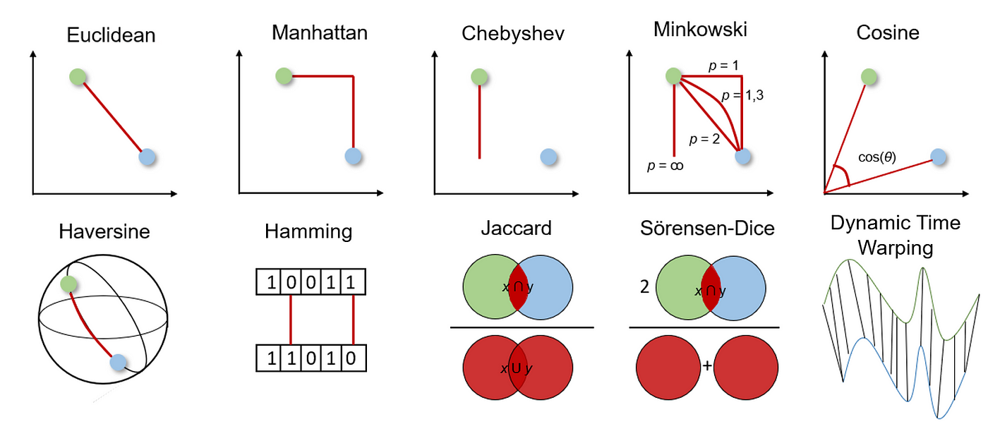

Slide 15
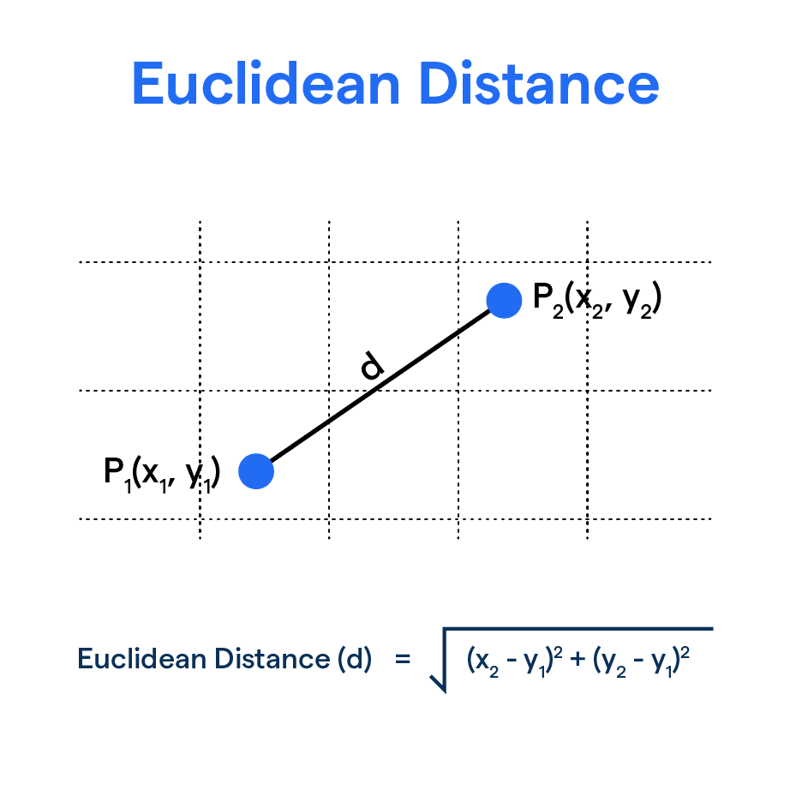
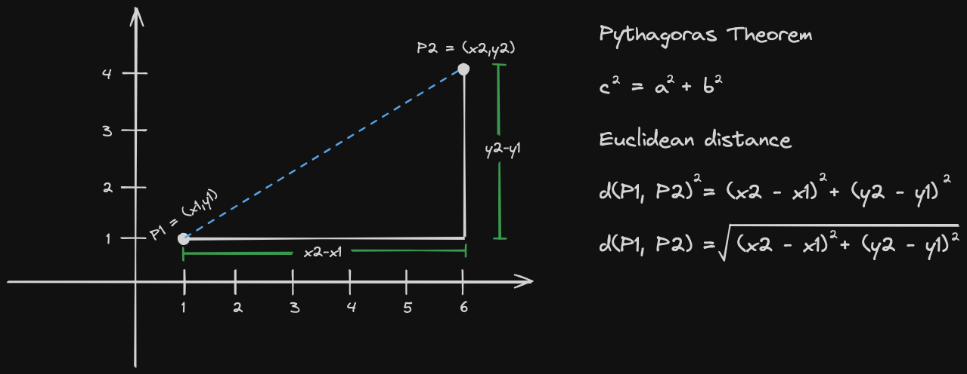

Slide 16
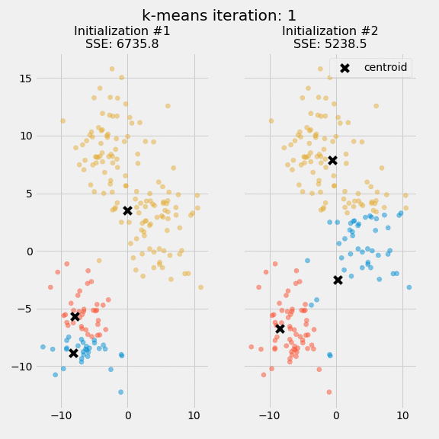
K-Means Clustering
Choose number of clusters (K)
Initialize K centroids randomly
Assign each data point to nearest centroid
Update centroids
Repeat until convergence
Evaluate the model
Within-cluster sum of squares (WCSS)
Silhouette score – Compactness vs separation
Elbow method – how many clusters

Slide 17
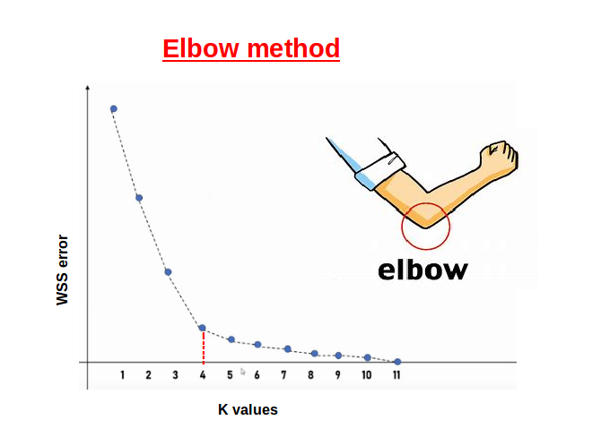

Slide 18
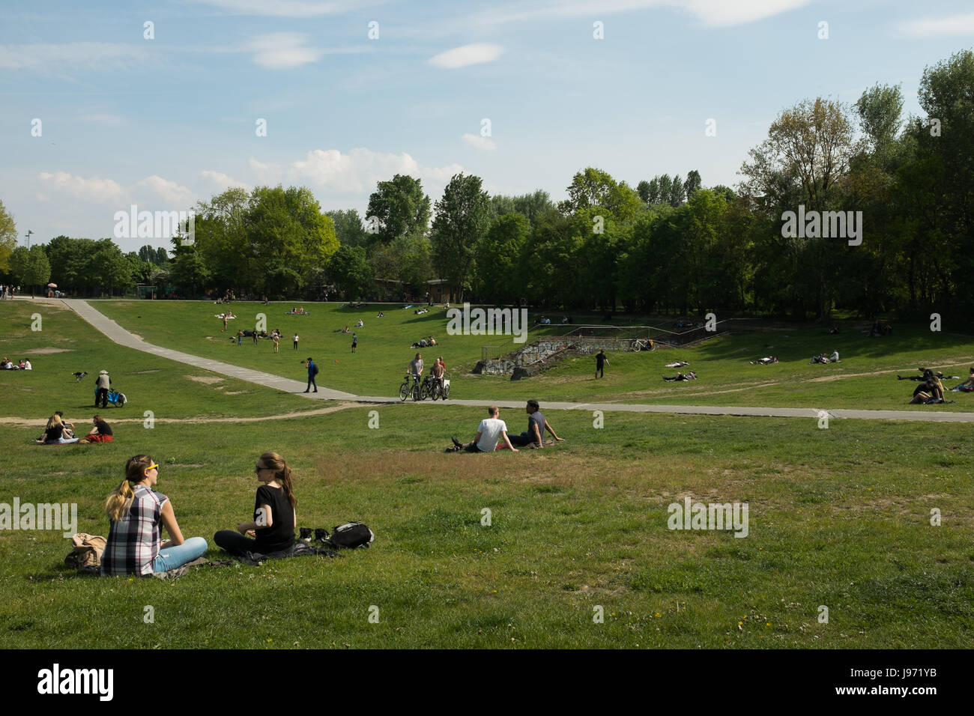
Density-Based Clustering
What if we have groups and also isolated individuals(outliers)
Think about grouping people in park:
Groups: picnic, soccer, joggers
Isolated: someone reading a book alone

Slide 19
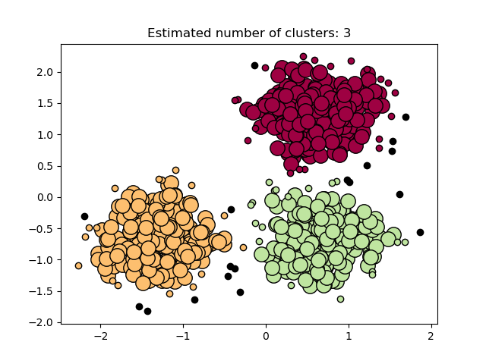
Demo of DBSCAN clustering algorithm

Slide 20
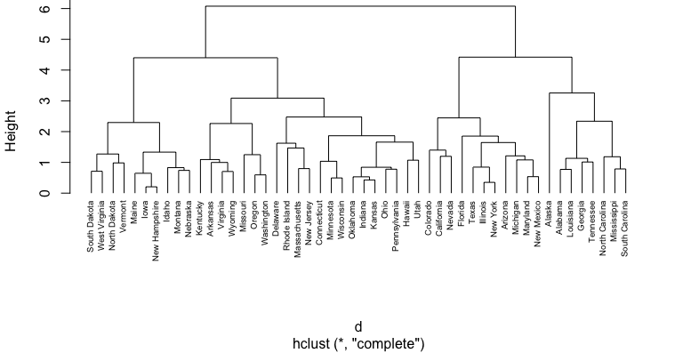
What if a group is embedded in a bigger group? Hierarchical Clustering

Slide 21
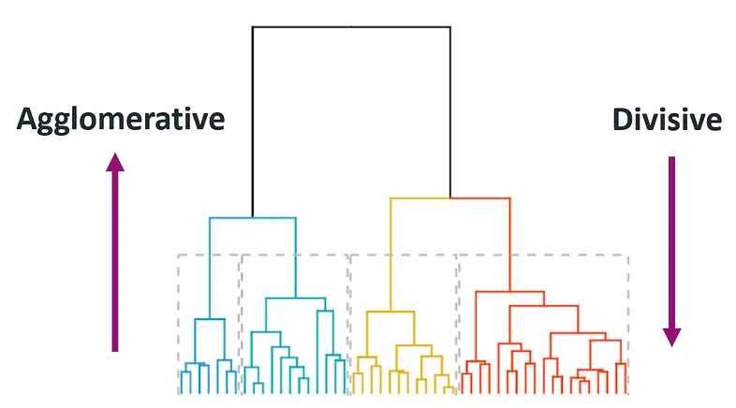
Hierarchical Clustering

Slide 22
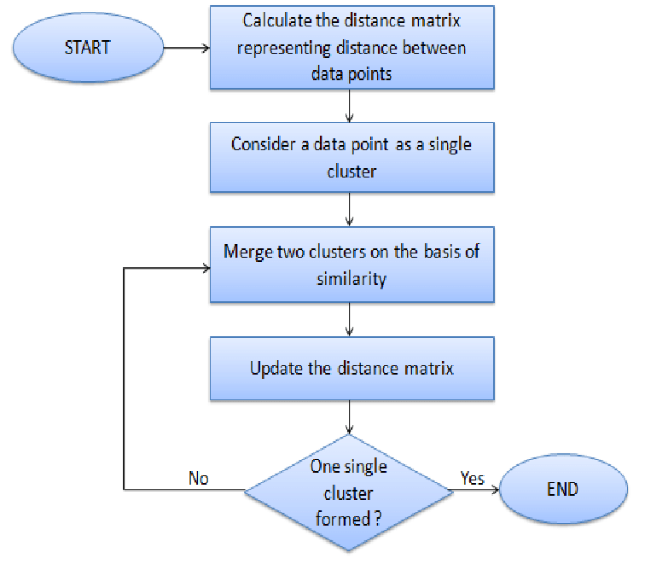
Agglomerative Hierarchical Clustering
How Does it work?
all data points as individual clusters
two nearest neighboring clusters are then joined to form one single cluster.
This process recursively happens until formation of desired number of clusters.

Slide 23
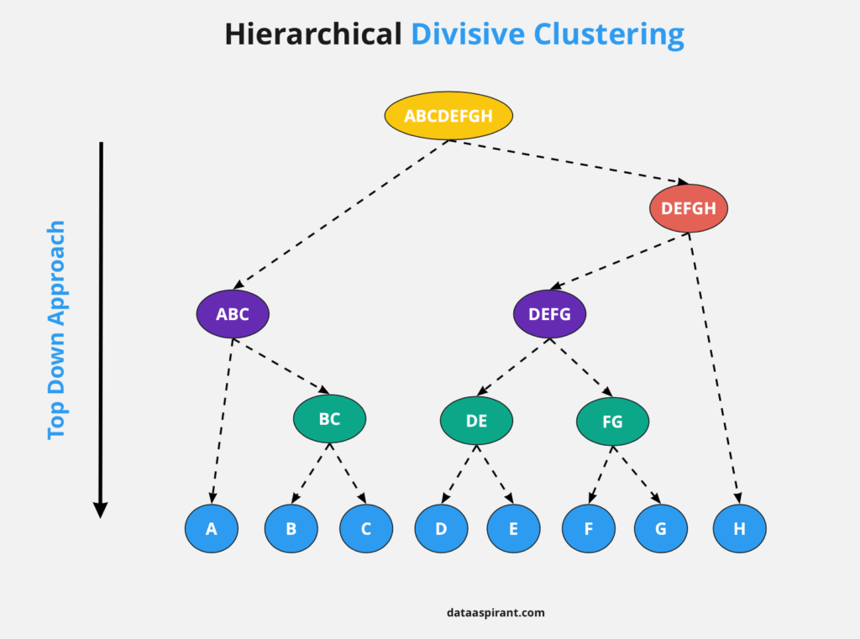

Slide 24
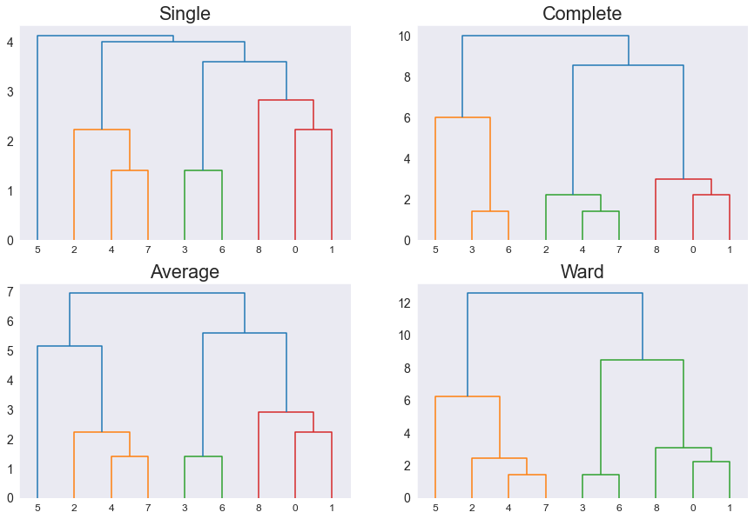
Hierarchical Clustering based on Linkage Methods

Slide 25
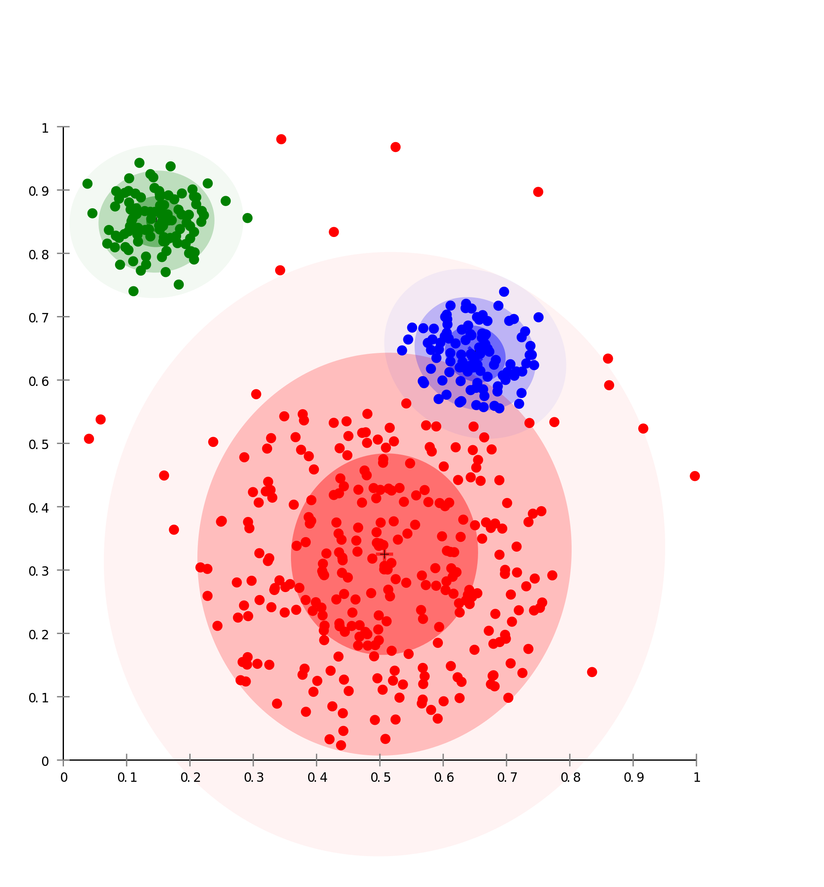
Standard Clustering Process
Feature extraction and selection
extract and select the most representative features from original data set
Clustering algorithm design
design clustering algorithm according to characteristics of problem
Result evaluation
evaluate clustering result and judge validity of algorithm
Result explanation
give a practical explanation for clustering result

Slide 26

Challenges for Clustering
Choosing right algorithm
Determining optimal number of clusters
Dealing with high-dimensional data
Handling categorical and mixed data
Ensuring stability and reliability of clustering
Evaluating and validating clustering
Interpretability

Slide 27
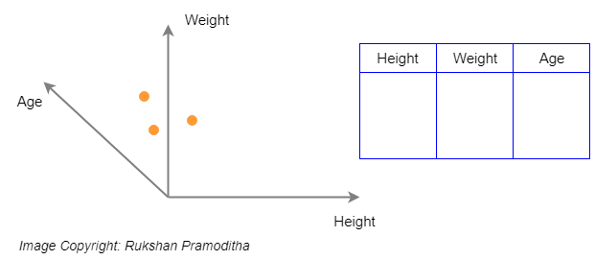
Dimensionality Reduction
Dimensionality reduction is process of decreasing number of attributes within a dataset while aiming to retain as much of original dataset’s variation .
Why do We Need Dimensionality Reduction?
Curse of dimensionality
Sparsity of Data
Increased Computational Complexity
Overfitting
Difficulty in Visualization

Slide 28
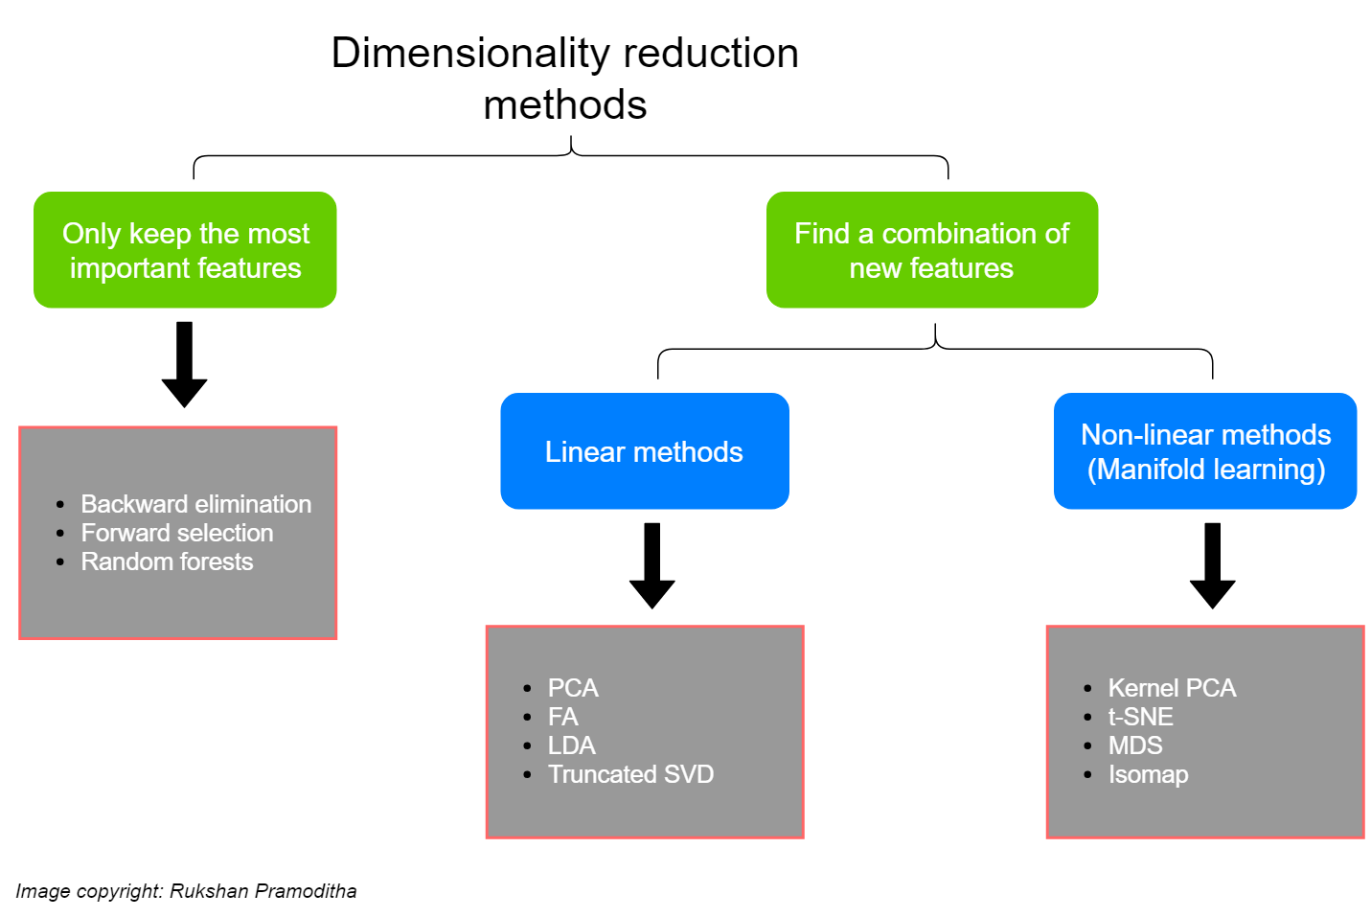

Slide 29
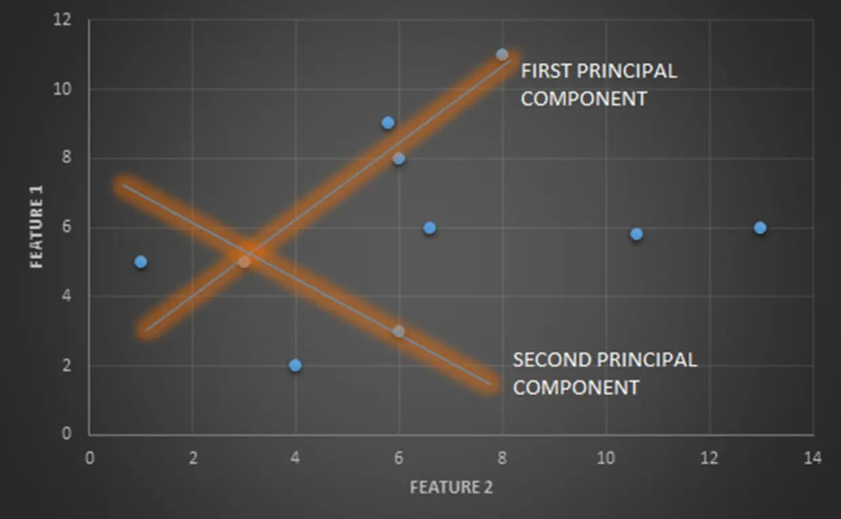
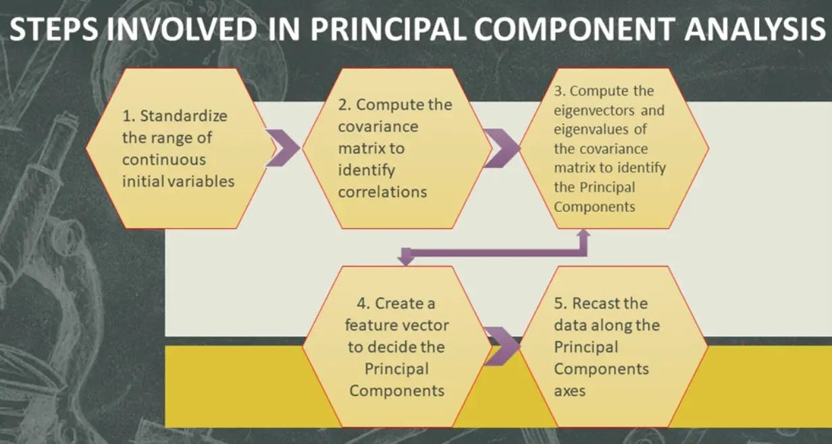
Principal Component Analysis

Slide 30
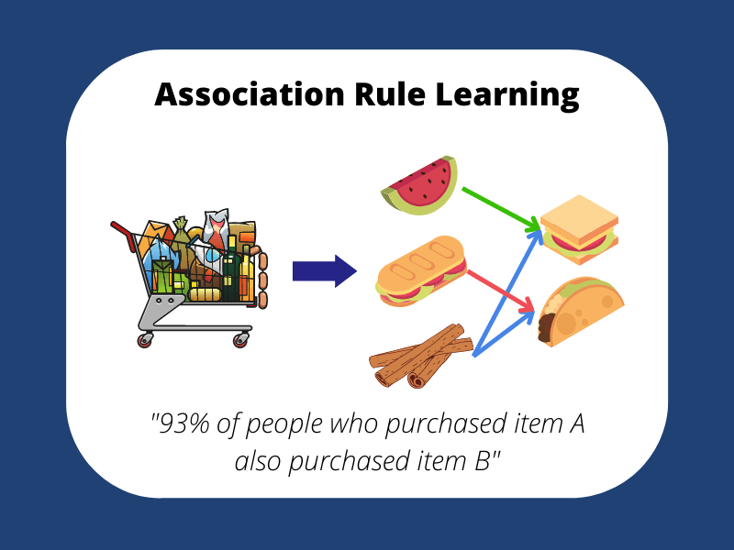
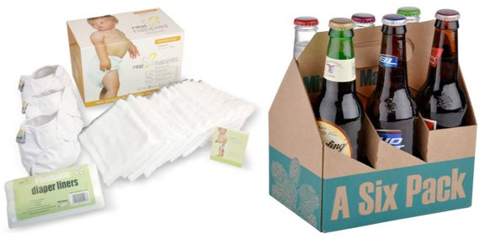
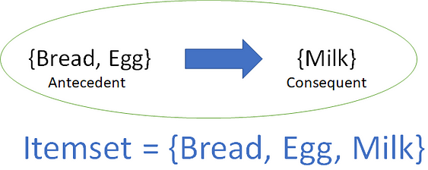
Association Rule Mining

Slide 31
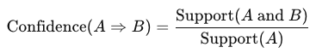
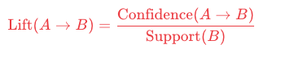
Association Rule Mining Example
Item | Transactions Containing Item | Total Transactions | Support (%) | Confidence (%) Milk ⇒ Bread | Lift Milk ⇒ Bread
Milk | 20 | 100 | 20 | - | -
Bread | 30 | 100 | 30 | - | -
Milk and Bread | 10 | 100 | 10 | 50 | 1.67

Slide 32
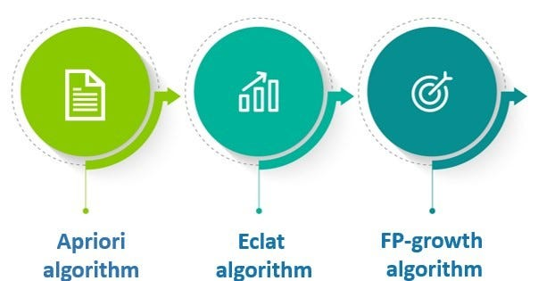
Association Rule Algorithms

Slide 33
Apriori
TID | Items Bought
1 | Bread, Milk, Beer
2 | Bread, Diapers, Milk
3 | Milk, Diapers, Beer
4 | Bread, Milk, Diapers, Beer
5 | Bread, Milk, Diapers
Frequent Itemset Generation
Step 1: Generate set of all single items (1-itemsets) and calculate their support. Prune those that do not meet the minimum support threshold.
Step 2: Generate 2-itemsets from the remaining frequent 1-itemsets and calculate their support, pruning as necessary.
Step 3: Repeat this process, each time generating itemsets that are one item larger, until no more frequent itemsets can be found.
Rule Generation

Slide 34
Types of Association Rules
Multi-relational association rules
Generalized association rules
Quantitative association rules
Interval information
association rules

Slide 35
Applications of Association Rule Mining
Market basket analysis
Cross-selling, store layout, promotions
Medical diagnosis
Symptoms and diseases
Recommendation systems
Recommender systems
Fraud Detection
Patters of frauds

Slide 36
Limitations of Association Rule Learning
Spurious Correlations
Lack of Causal relations
Data Quality
Curse of Dimensionality
Interpretation
Need for Domain Knowledge

Slide 37
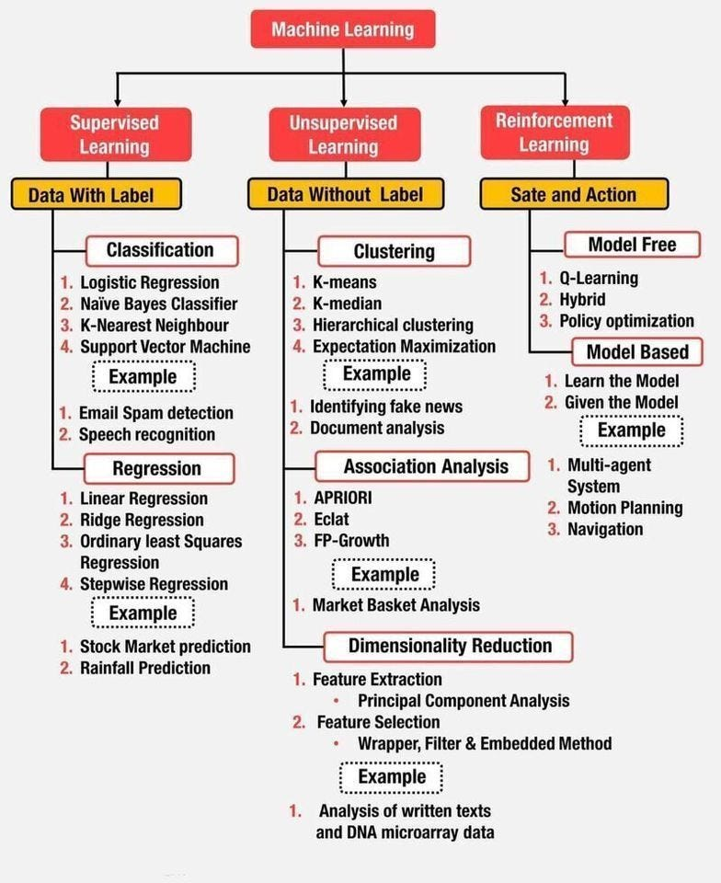
In a Big Picture: Algorithms Based on Types of ML

